Slide 1

Drone Image Data Collection Using the Tello EDU

Slide 2
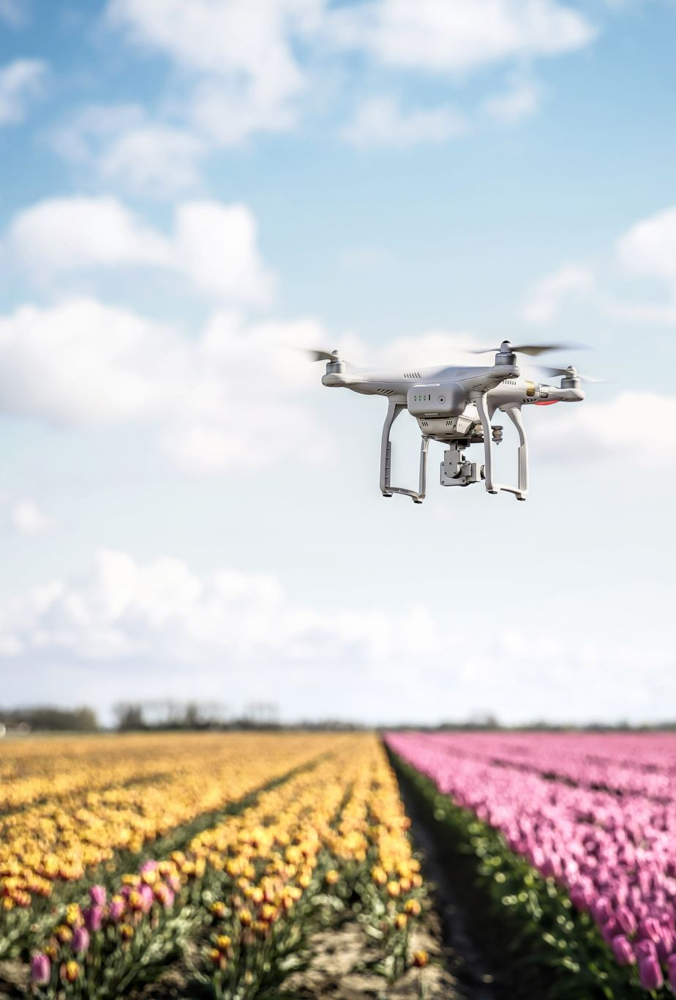
Roadmap
Intro to the Tello EDU Drone
Overview of the Drone Obstacle Avoidance Module
Step-by-Step Guide to Collect Image Dataset

Slide 3
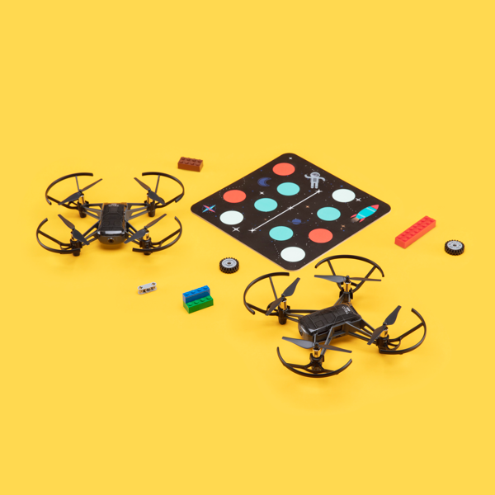
Intro to the Tello EDU Drone
Small and lightweight quadcopter designed for educational purposes in robotics programming
Key features of the Tello (when compared to other drones) are as follows:
Programmable: Flight patterns can be dictated through programming Python or Scratch
Tello SDK: The Tello SDK (Software Development Kit) allows for advanced programming to create custom applications and control the drone’s behavior
Native Sensor Integration: The Tello comes equipped with a plethora of powerful sensors such as (1) 720p HD Camera, (2) IMU (Inertial Measurement Unit), (3) downward-facing camera, and more!

Slide 4
Drone Obstacle Avoidance Module Overview
The goal of this module is as follows:
1. Generate a dataset consisting of images depicting the Tello’s path being BLOCKED or UNBLOCKED by cardboard boxes
2. Train a CNN model which will be able to determine whether an image classifies as BLOCKED or UNBLOCKED
3. Use the trained model to perform inference in collaboration with a flight control scheme so that the Tello will autonomously avoid our cardboard box obstacles

Slide 5





Step-by-Step Guide to Collect Dataset

Slide 6
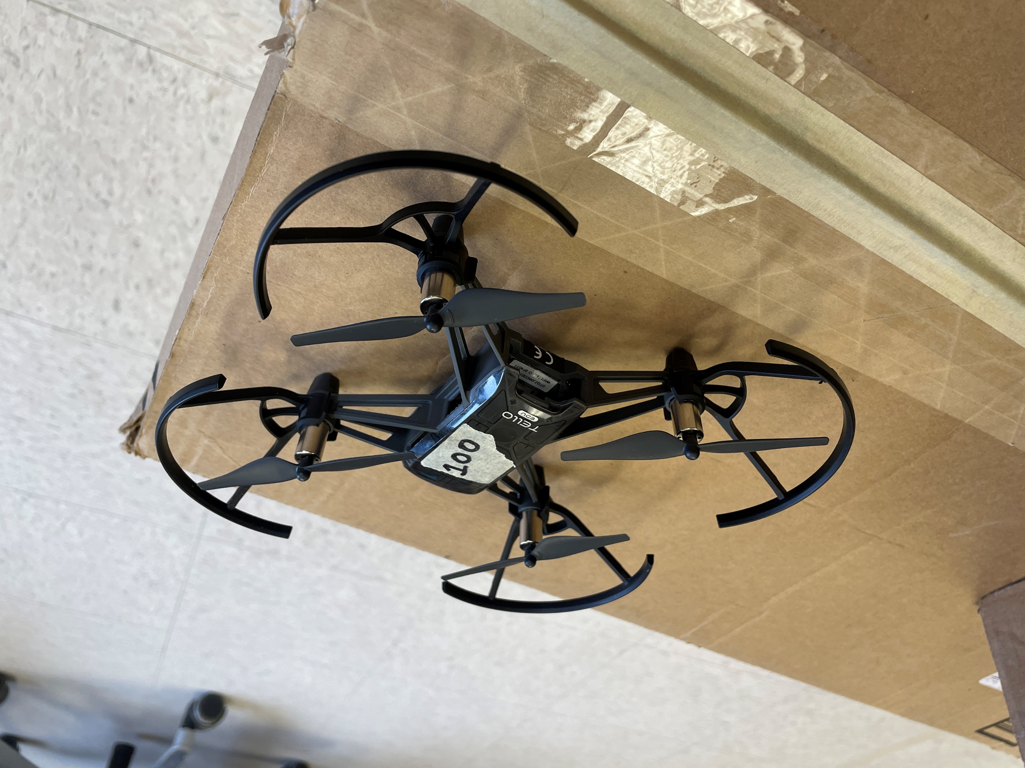
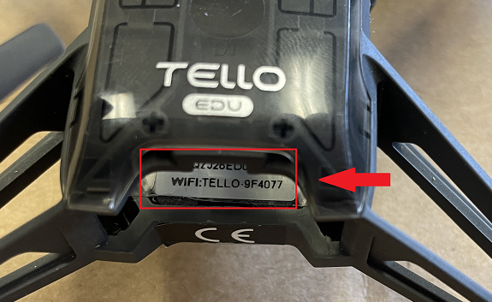
Connecting to the Tello
Remove the battery pack from the Tello by pulling from the tab
Make note of the WIFI name as depicted on the sticker from the bottom image
When turned on, the Tello will create a WIFI hotspot which we will connect to
In this example, my WIFI name will be “TELLO-9F4077”

Slide 7
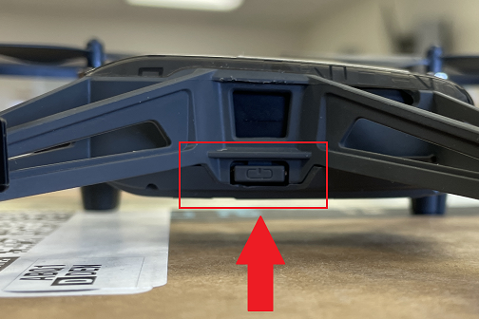
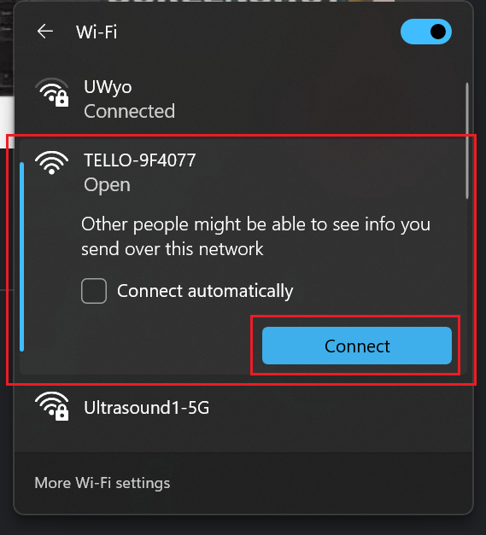
Connecting to the Tello (cont.)
Re-insert the battery pack into the Tello (push until you feel a “click”) and press the power button once to turn it on
The LED on the front of the Tello should start blinking an array of different colors
Once the LED starts blinking yellow, the WIFI should popup as an available connection (may take a few moments) on your Laptop
Once available, simply connect to it as you would any other WIFI (password should not be required)

Slide 8
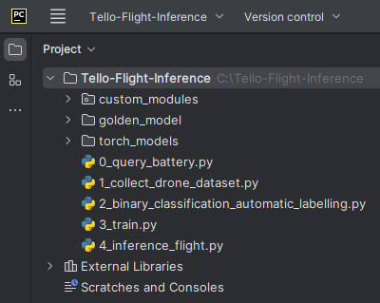
Ensuring Tello Connection
Open the “Tello-Flight-Inference” directory in PyCharm on your laptop (also be sure to copy "Tello-Flight-Inference to your desktop computer, this will be helpful later)
The project structure should look something like the following image

Slide 9
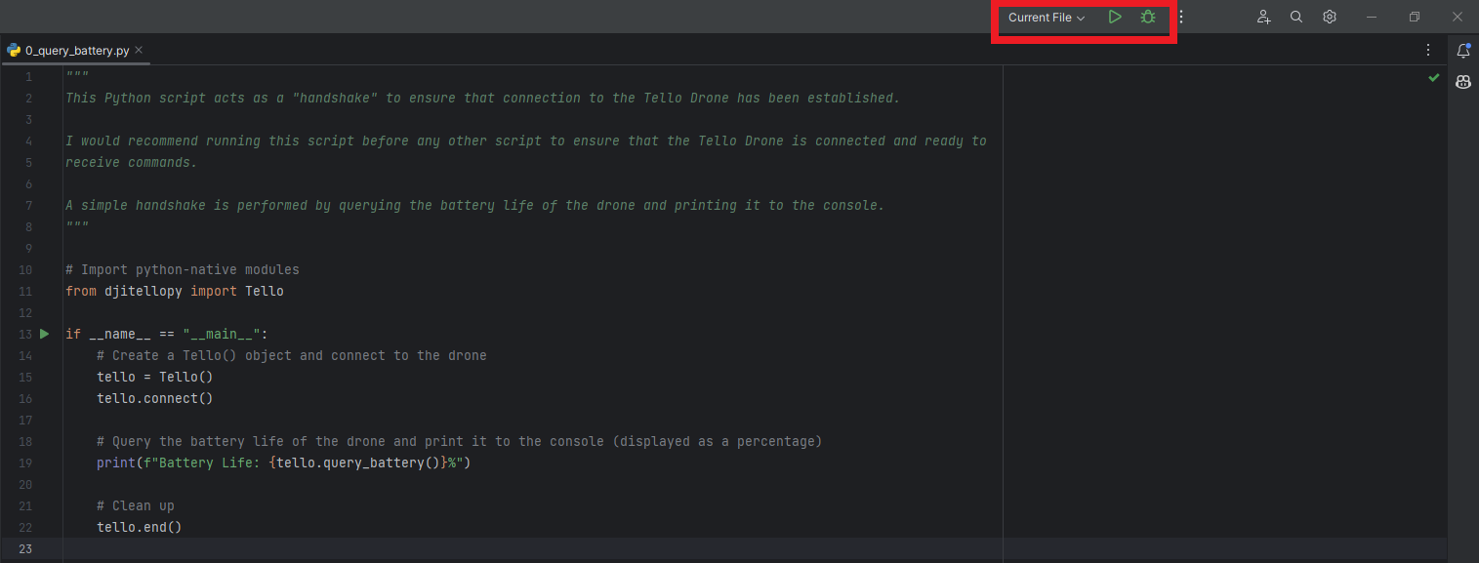
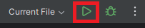
Ensuring Tello Connection (cont.)
Double-click on “0_query_battery.py” to open the file in an Editor Window
Once the file is open, ensure that “Current File” is depicted in the upper-right-hand corner and press the Green Play Button to launch the script
This script ensures that a valid connection to the Tello has been established by simply querying for the battery percentage

Slide 10
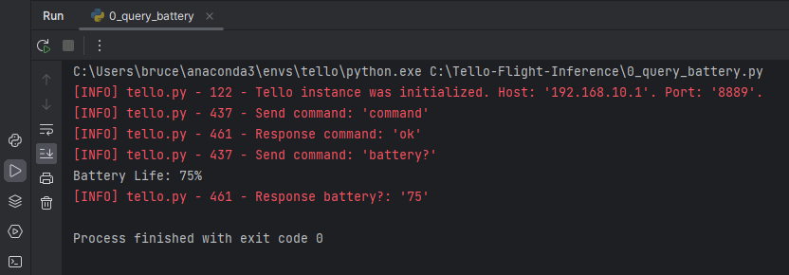
Ensuring Tello Connection (cont. again)
If the connection is valid, you should see an output in the “Run” Terminal (bottom of the PyCharm Window) like the following:

Slide 11
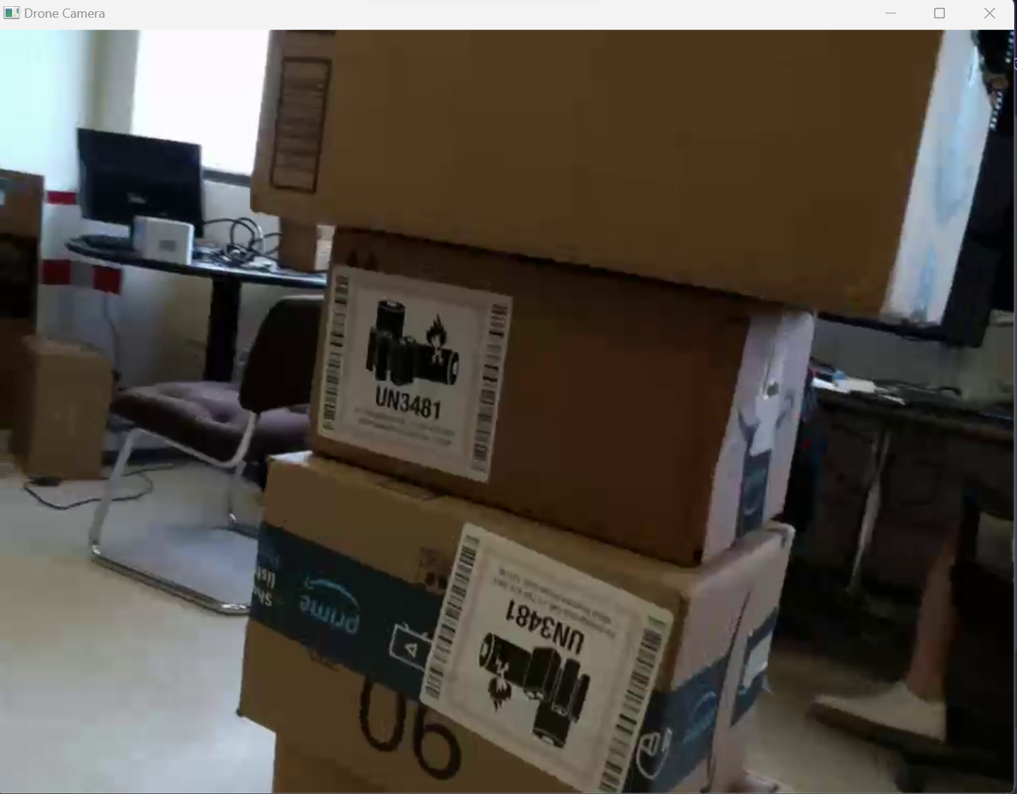
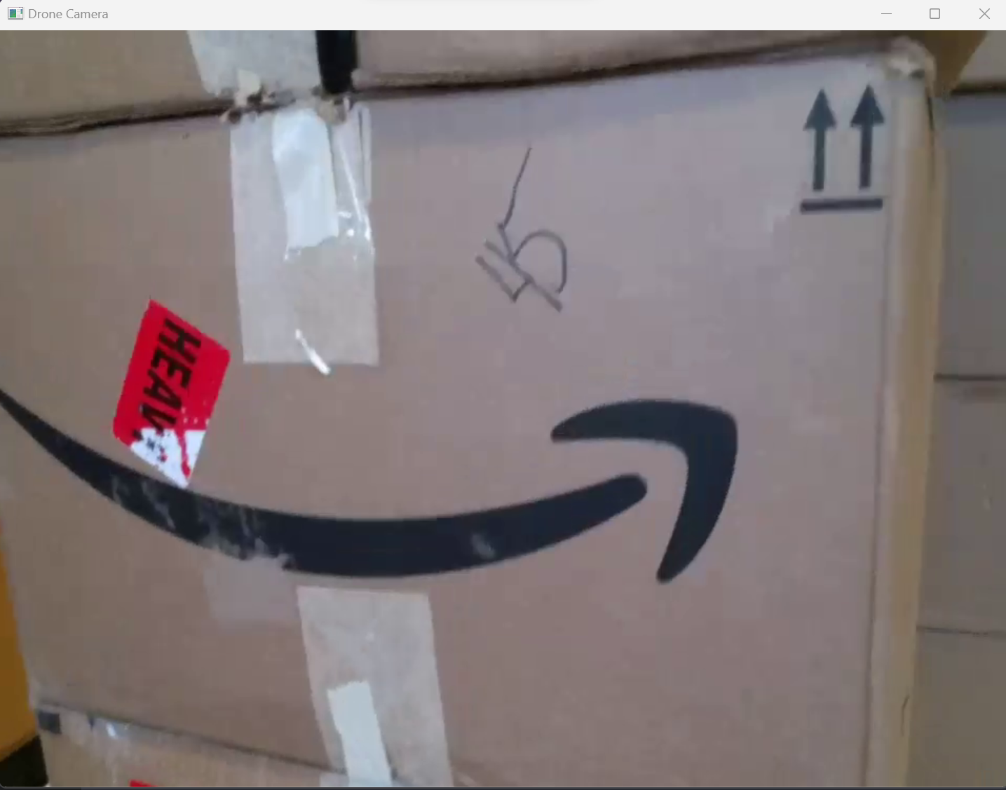
Using the Dataset Collection Script
Similar to the prior example, double-click on “1_collect_drone_dataset.py” and press the Green Play Button in the upper-right-hand corner to begin collecting your dataset
After a few seconds, you should notice that a popup window shows up depicting a live video feed from the Tello (use this as a reference on how your image capturing is going)
Holding the Tello Drone at waist height, (1) keep it relatively level, (2) start moving around the boxes at different angles, (3) be sure to rotate the drone in addition to moving it around for a variety of image captures

Slide 12
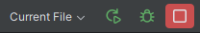
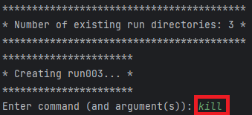
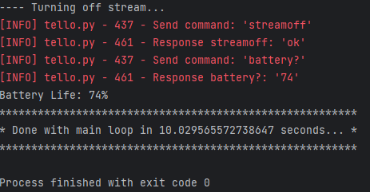
Using the Dataset Collection Script (cont.)
Once you’re done collecting your images, either:
(1) Press the Red Stop Button now located in the upper-right-hand corner of the PyCharm window
(2) Type in “kill” and press ENTER in the command line prompt from the “Run” Terminal
Once the run has successfully stopped, the popup window should close and your terminal should have a printout similar to the following bottom image

Slide 13
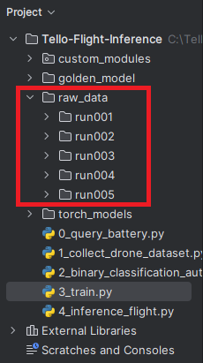
Using the Dataset Collection Script (cont. again)
Once your current run has terminated, you should notice an additional directory named “raw_data”
Each subdirectory (run00X) houses all your images for a given run
Subsequent runs of this script will create a subdirectory (run00(X+1))
In this example, I did 5 runs
Feel free to do as many runs as you see fit to generate a larger dataset!

Slide 14
Using the Dataset Organization Script
Now we want to organize our “raw_data” dataset into a directory structure for individual TEST, TRAIN, and VAL datasets, where each of those datasets depicts BLOCKED and UNBLOCKED
To do so, “2_binary_classification_automatic_labelling.py” will (1) iterate through each image in our “raw_data” dataset, (2) pass the image through a “golden model” to label it as BLOCKED or UNBLOCKED and (3) automatically organize our newly labelled images into the described directory structure
This approach can be considered as semi-supervised learning

Slide 15
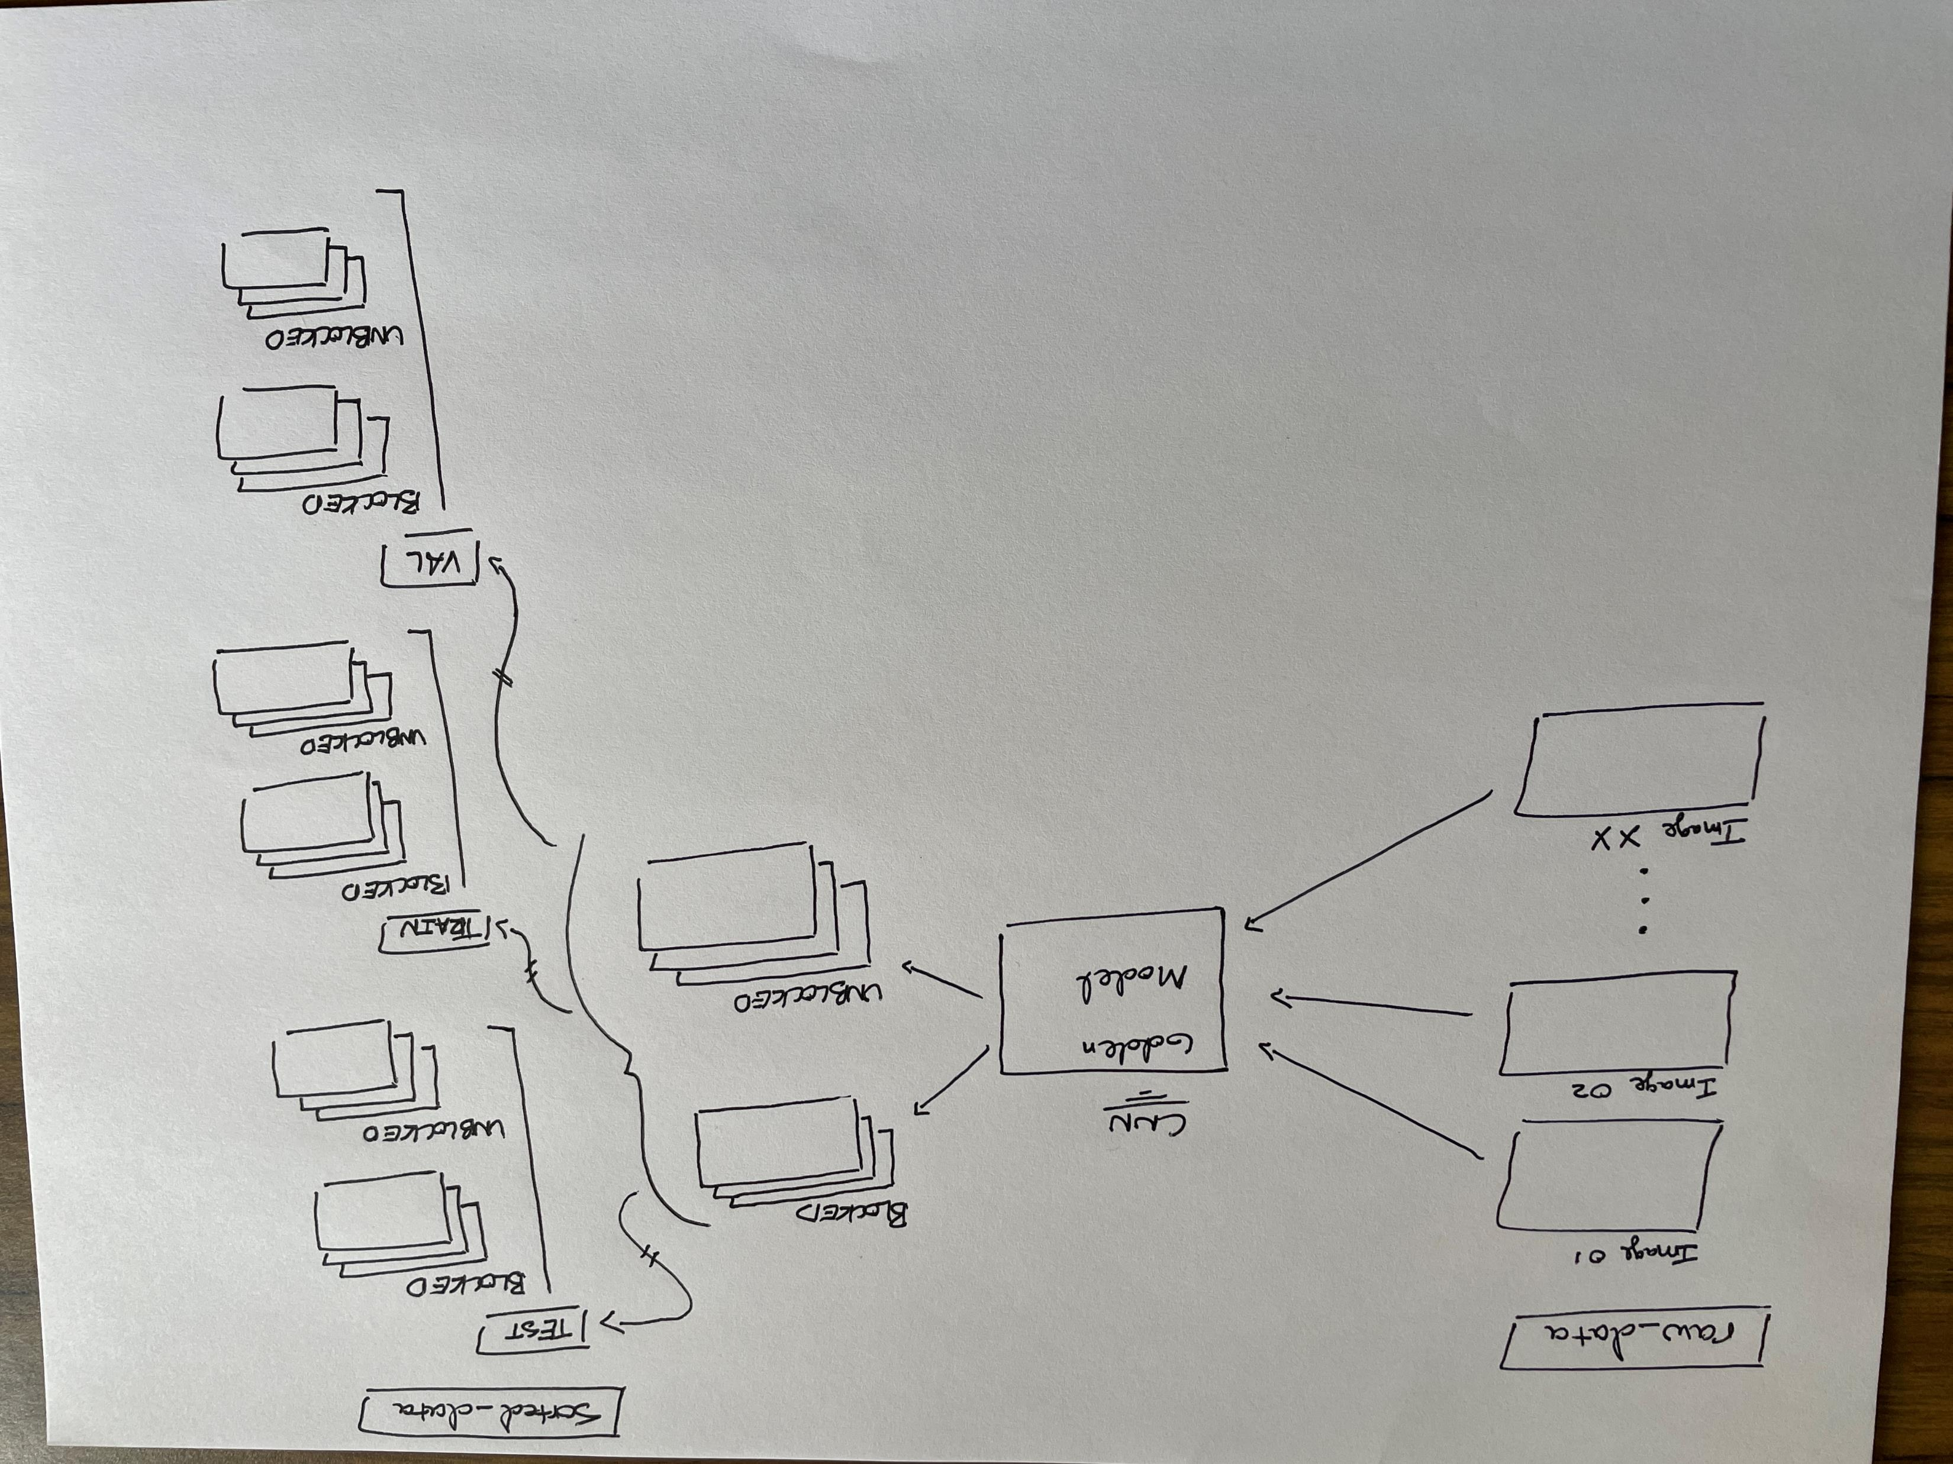
Dataset Organization Script Visualization

Slide 16
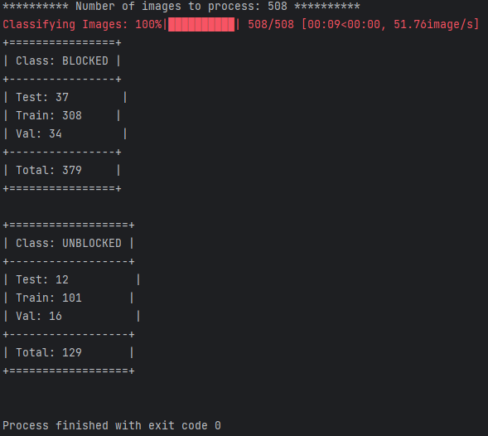
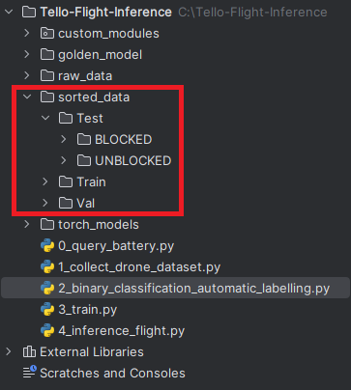
Using the Dataset Organization Script (cont.)
Double-click “2_binary_classification_automatic_labelling.py” to open it in the Editor Window
Click the Green Play Button to automatically organize your new dataset, a progress bar will be shown in the “Run” Terminal showing your progress
Once the script has completed, a printout will be shown depicting a summary of the sizes of your TEST, TRAIN, and VAL datasets
You should also notice a new directory “sorted_data” has been made with the structure illustrated from the previous slide
Transfer your new "sorted_data" directory from your laptop to your desktop computer that you have been using throughout this workshop (we will train our model on the desktop)

Slide 17
For tomorrow…
We will train a CNN model to classify our newly generated dataset
We will take autonomous flight leveraging our newly trained model!

